Slide 1


etflix
Dataset Analysis
Utilizing Python Libraries for Data Exploration
-By vedansh shrivastava

Slide 2


Introduction
This project focuses on analyzing Netflix dataset , focusing on various data analysis techniques using Python functions and libraries

Slide 3



Objectives
  Load and clean the Netflix dataset
  Understand the dataset’s structure
  Perform exploratory data analysis (EDA)
  Drive Strategic Decision-Making
Scope
  This project analyzes a Netflix dataset , using python and Pandas to explore and gain insights into its structure and content

Slide 4



Workflow
Data Collection and Loading
Data Cleaning and Transformation
Data Storage and Management
Data Analysis and Insights

Slide 5
Data Collection and Loading
Data Sources
  Netflix dataset containing information about movies, TV shows, directors, cast, genres, countries, duration, and ratings.
Data Loading Process
  Data is loaded into a Pandas Data frame using pd.read_csv () after importing the Pandas library in Python.

Slide 6


DATA CLEANING

Slide 7
  Enhancements in Netflix Data Set
  Identify missing values using the is null() function
  Remove rows with missing data using the dropna() function
  Delete duplicate records with the duplicate() function
  Remove duplicates using the drop_duplicates() function
  Filter and group data using functions like str . contains (), isin(), and group by()
  Create new columns and filtered Data Frames as needed for analysis.
  Ensure data quality before moving on to visualization and further exploration.

Slide 8

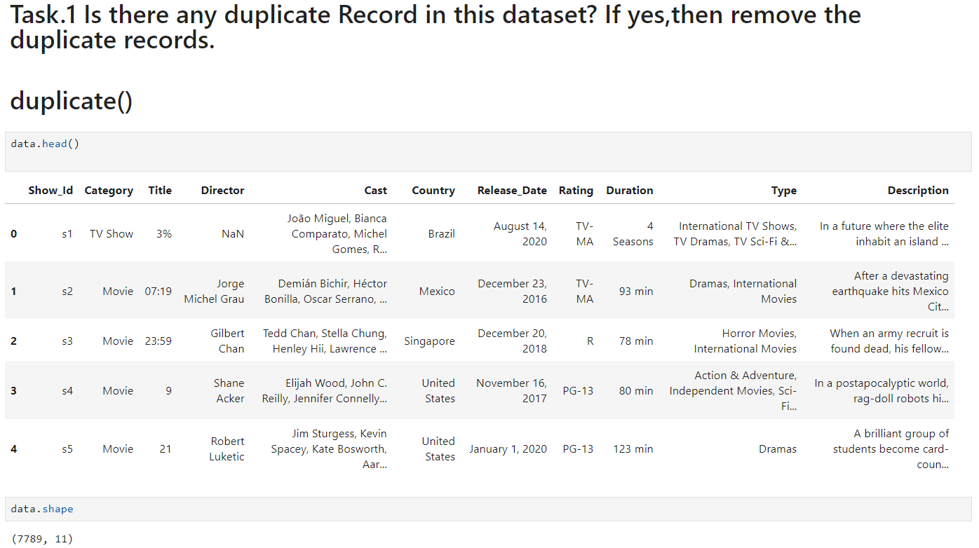
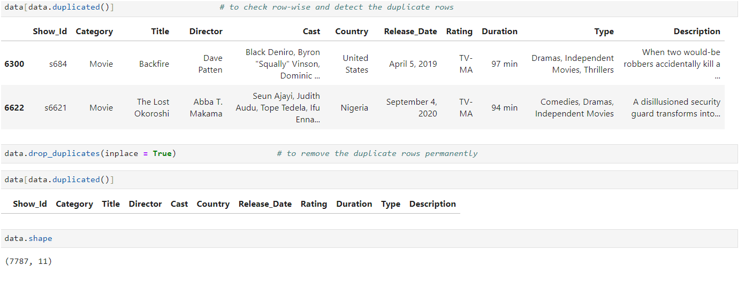
DATA CLEANING

Slide 9
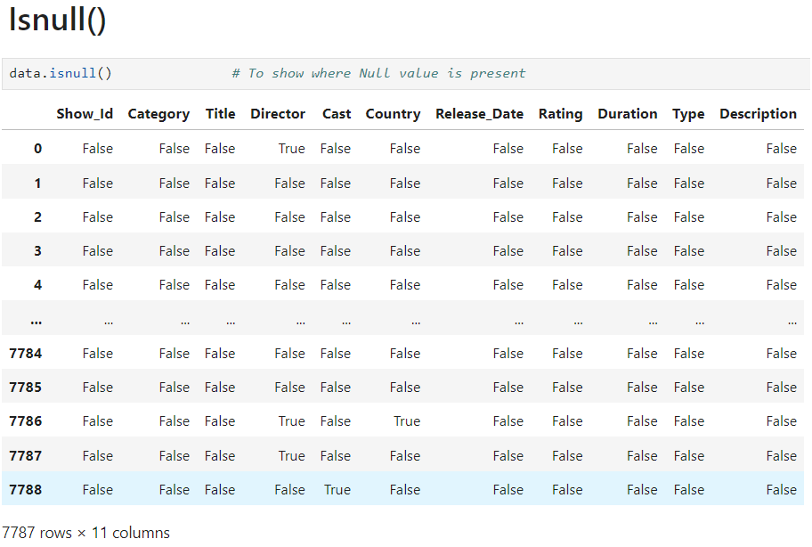
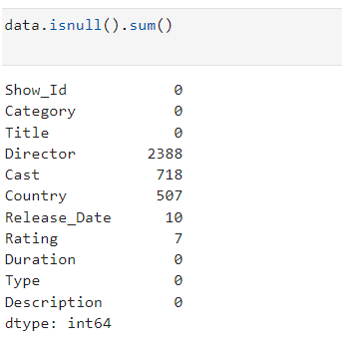
2. Check Null Values
To identify missing values use the isnull() function to check for entry and find True for null values. Apply this to the Data-frame and use .sum() to count the nulls in each column.

Slide 10
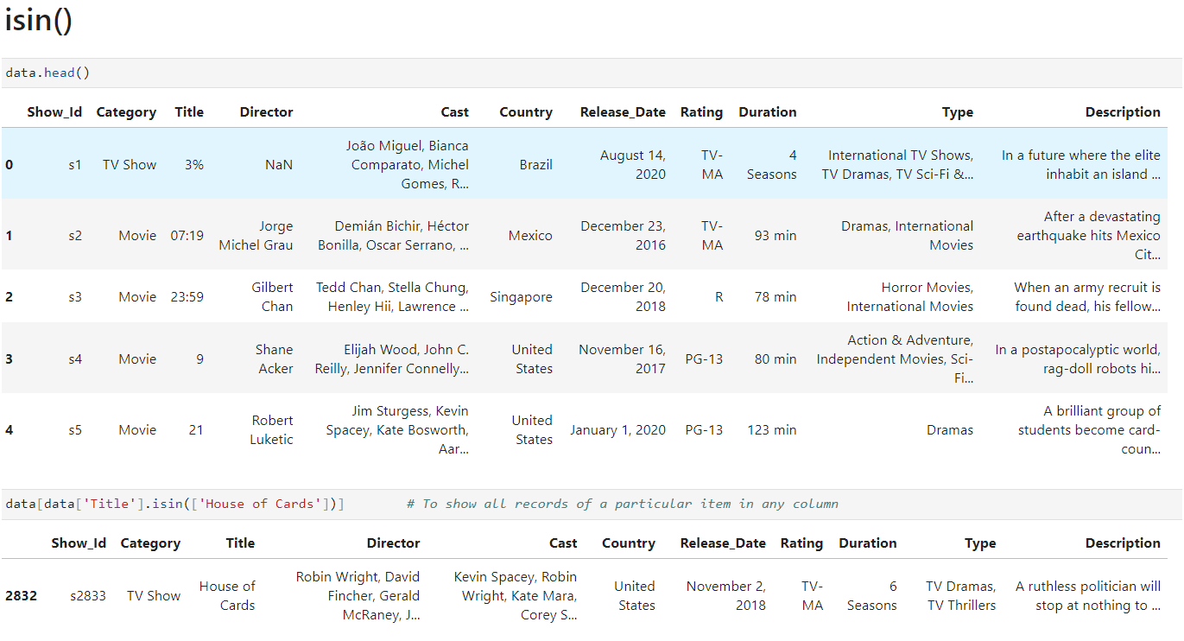
Q3.For 'House Of Cards’, what is the show id and who is the director of this show?

Slide 11
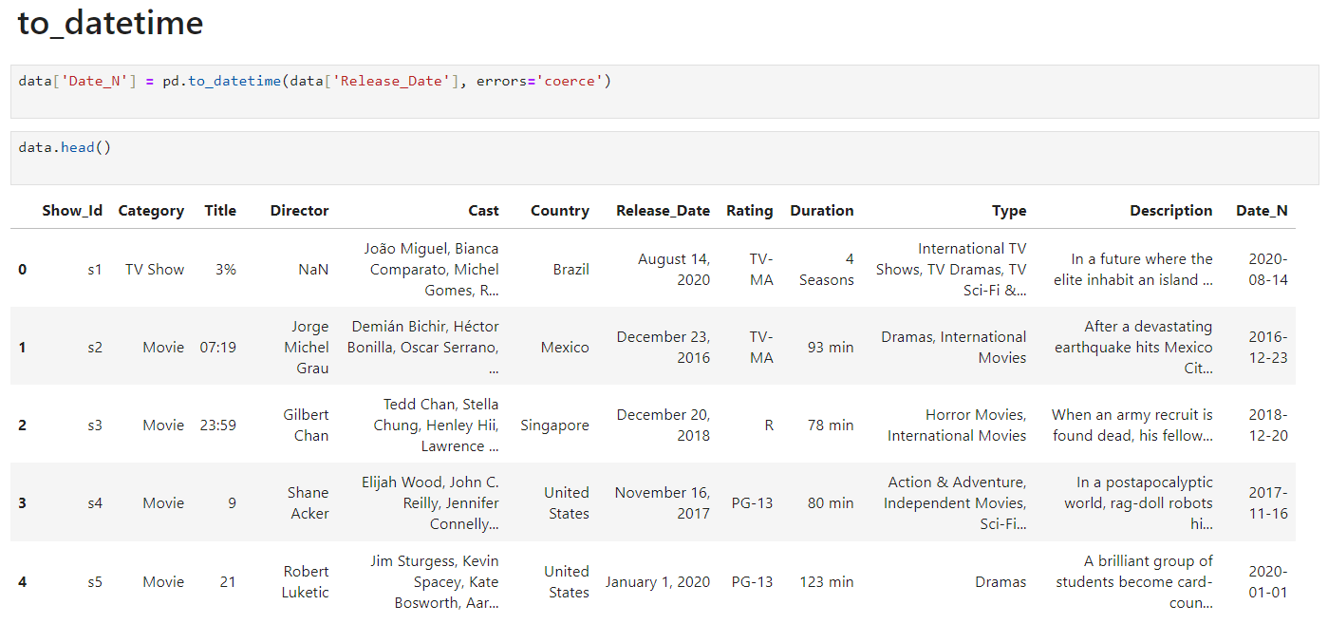
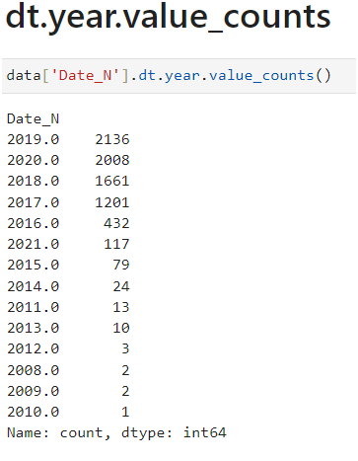
Q4.In which year highest number of the TV Shows and Movies were released Show with Bar Graph

Slide 12
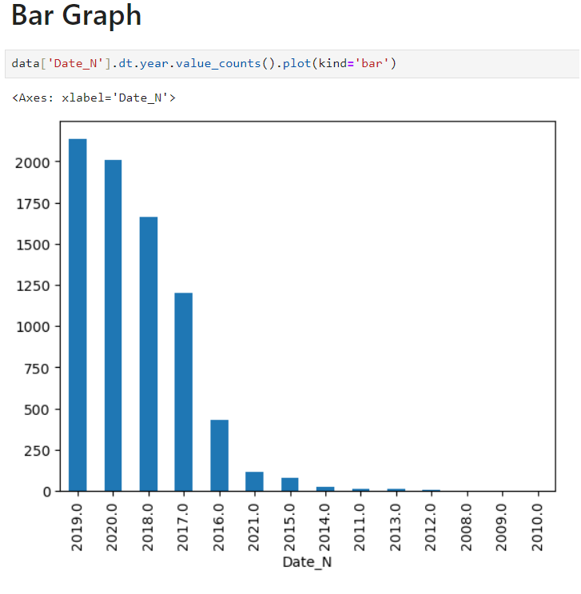
The bar graph shows the count of data points for each year in the "Date_N" column. The year with the highest count is 2019, followed by 2020 and 2018.
.

Slide 13
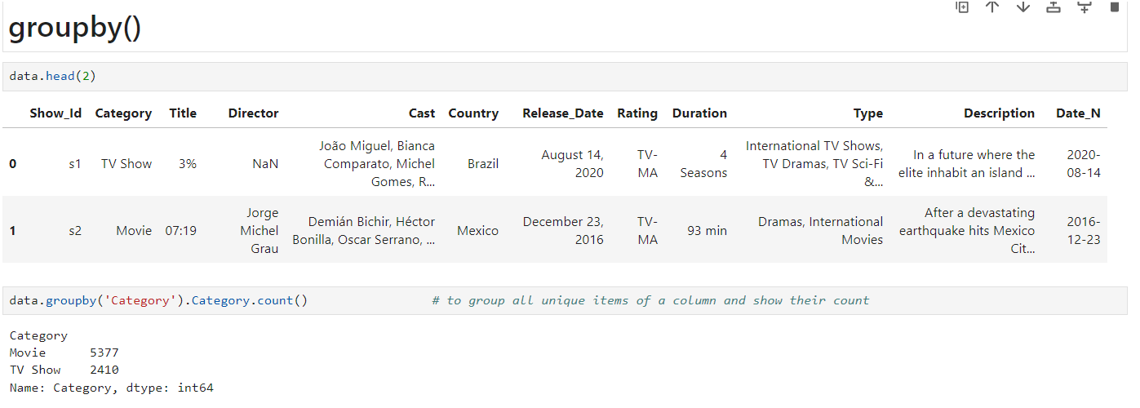
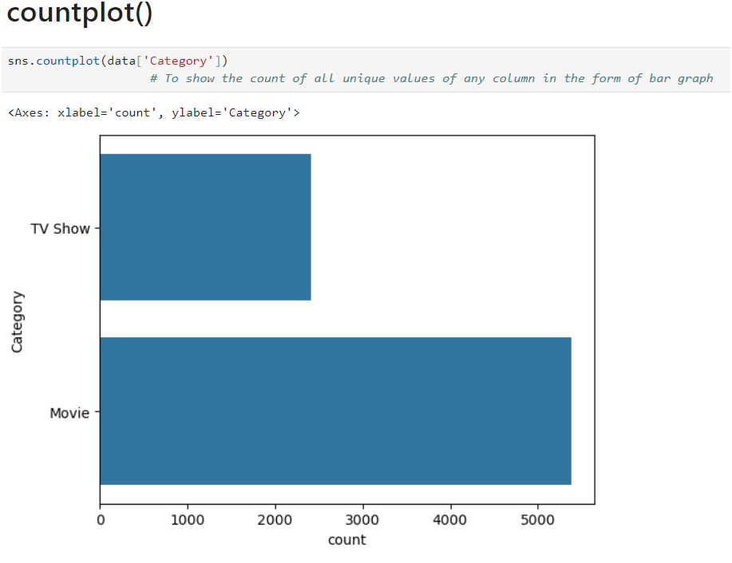
Q5.How many Movies & TV are in the dataset? Show with Bar Graph

Slide 14
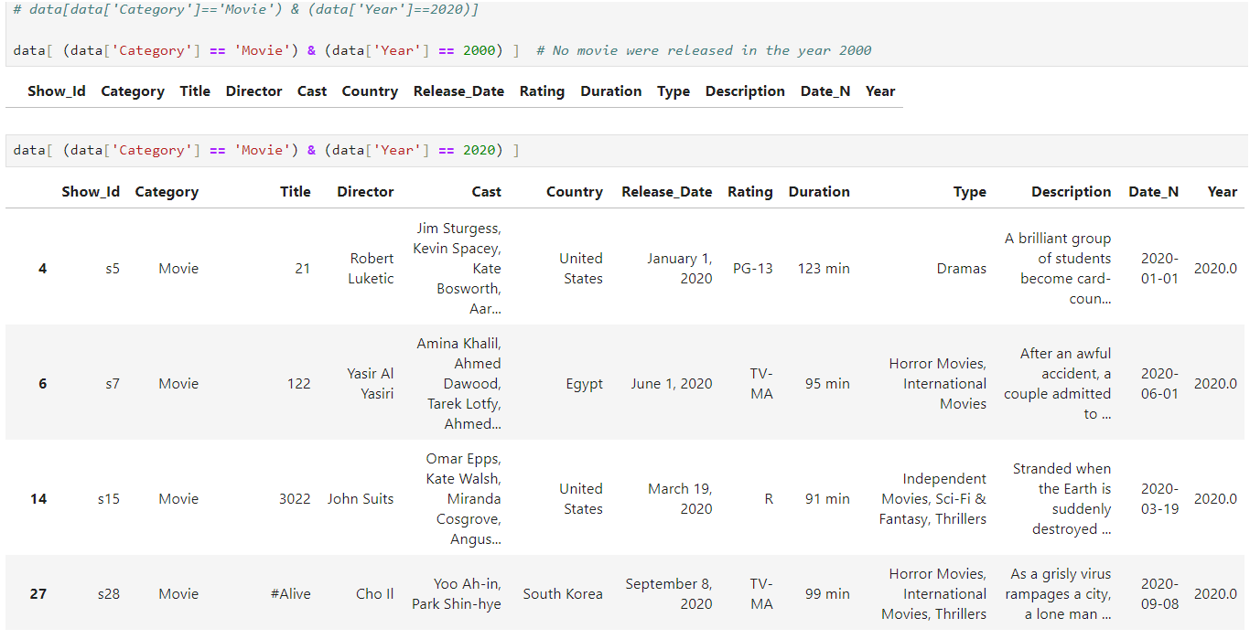
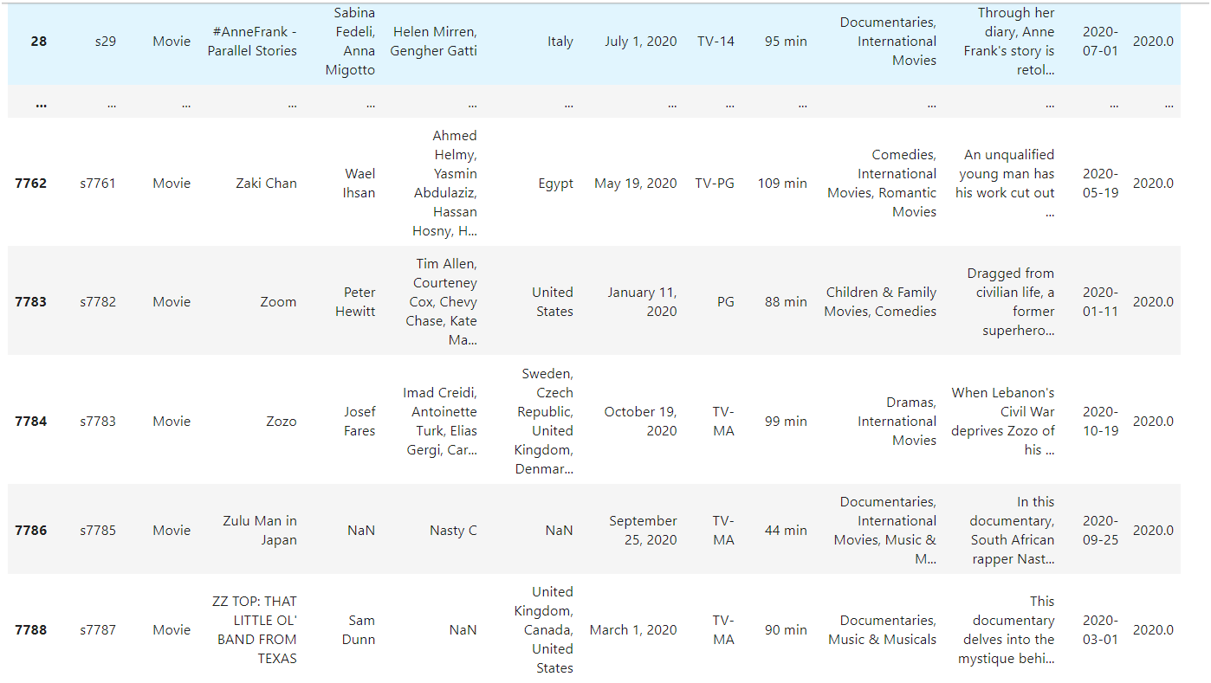
Q6. Show all the Movies that were released in year 2020

Slide 15
DATA ANALYSIS

Slide 16
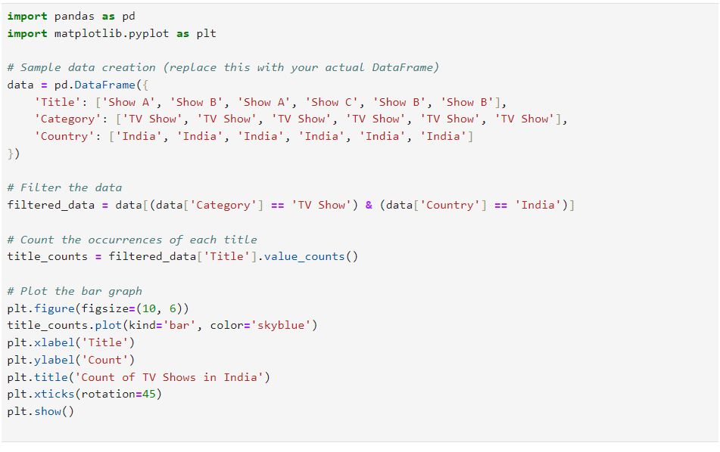
  Show only the Titles of all TV Shows that were released in India only.

Slide 17
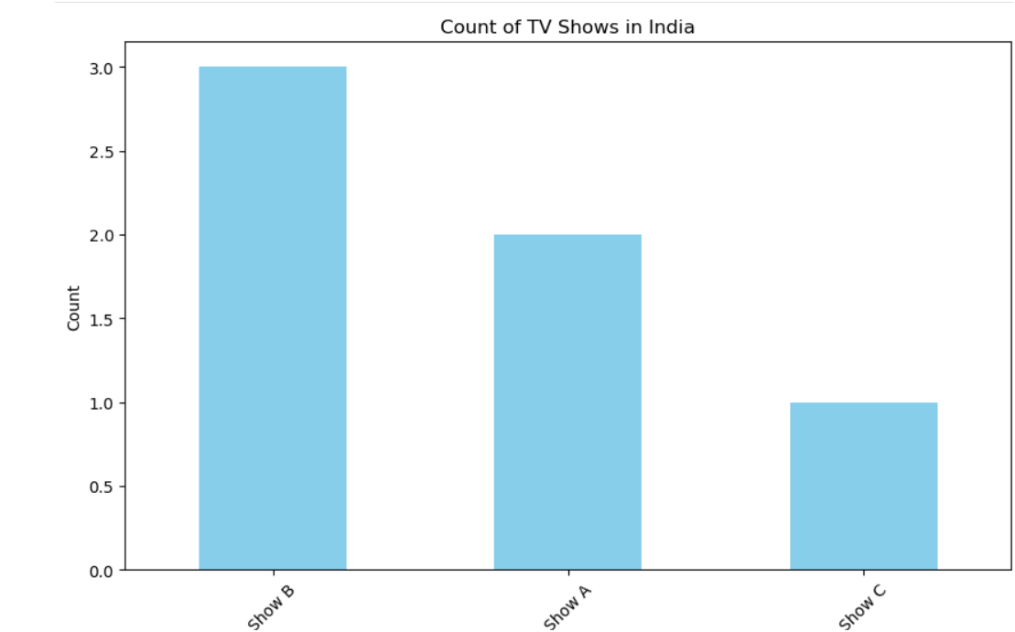

Slide 18
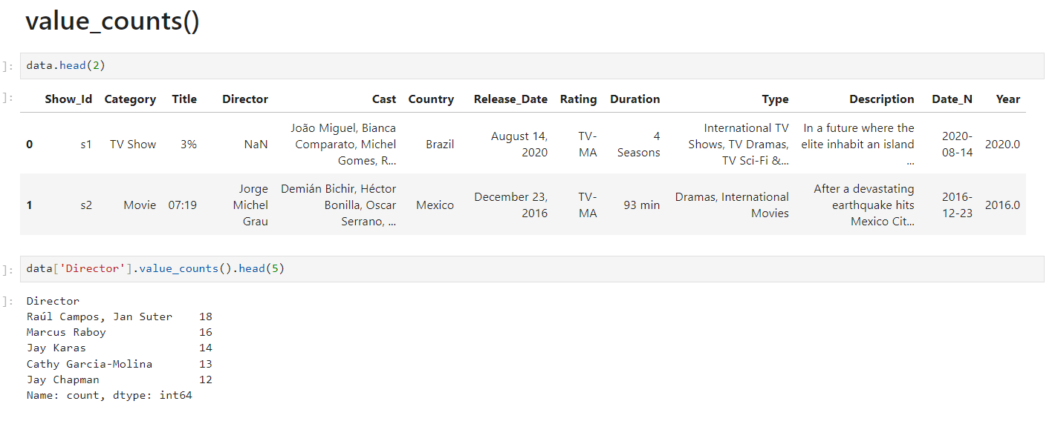
Q2. Show Top 10 Directors, who gave the highest number of TV Shows & Movies to Netflix?

Slide 19
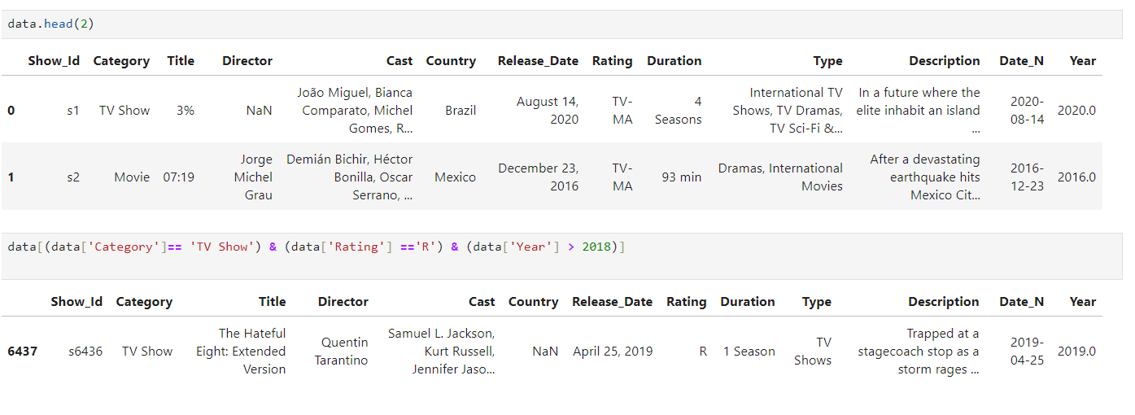
Q3. How many TV Shows got the 'R' rating after year 2018?
]:

Slide 20
Insights and Results

Slide 21
Key Findings
  Dataset Structure: The dataset consists of 7789 rows and 11 columns, including columns like Show Id, Category, Title, Director, Cast, Country, Release Date, Rating, Duration, Type, and Description.
  Data Overview: The head() function reveals the first 5 records, while the tail() function shows the last 5 records, providing a snapshot of the dataset’s content .
  Shape and Size: The shape command indicates the dataset's dimensions (7789 rows and 11 columns), while the size command shows a total of 85,679 elements, highlighting the dataset's extensive scope..

Slide 22
Business Impact
  Data Overview and Insights:
  The dataset contains 7789 rows and 11 columns, offering a comprehensive view of various TV shows and movies.
2. Understanding Dataset Structure:
Shape Analysis: The dataset’s 7789 rows and 11 columns reveals its shape and scope .
Size Analysis: With 85,679 elements, the dataset offers extensive information for detailed analysis
3 Informed Decision-Making
  Data-driven insights enable precise resource allocation and competitive positioning.

Slide 23

Thank you!
For exploring this presentation on the Netflix data analysis project. Your interest and engagement are greatly appreciated as we continue to uncover valuable insights from the data.

